Slide 1
AE 51019: Smart Structures
Instructor: Mira Mitra
mira@aero.iitkgp.ernet.in

Slide 2
Textbooks
Smart Structures Theory --- I. Chopra & J. Sirohi, Cambridge University Press, 2013
Smart Structures - A. V. Srinivasan & D. M McFarland
Cambridge University Press, 2001
Smart Material Systems --- D. J. Leo
Wiley, 2007

Slide 3
Evaluation Policy
Quizzes: Best two of three – 20 %
Mid-sem. Exam - 20%
Group Project - 20%
End-sem. Exam – 40%

Slide 4
Content
Introduction to smart structures
Introduction to smart materials
Piezoelectric actuators & sensors
Fundamentals of piezoelectricity
Basic piezoceramic characteristics
Electromechanical constitutive equations
Modeling of piezoelectric actuators
Modeling of piezoelectric sensors

Slide 5
Shape Memory Alloys (SMA)
Fundamentals of shape memory behavior
Constitutive modeling
Actuation models of SMA
Electrical activation of SMA
Electrorheological (ER) & Magnetorheological (MR) Fluids
Fundamental composition & behavior of ER/MR fluids
Modeling of ER/MR fluid behavior
Modeling of ER/MR fluid damper

Slide 6
Applications of smart structures
Vibration control
Structural Health Monitoring
Energy Harvesting
Project presentation by students

Slide 7
What is a “Smart” system?
(intelligent, adaptive, active, sensory)
Twentieth century definition:
A system with the capability to adapt their characteristics/behavior
as required, monitor their health condition, perform self-diagnosis &
self-repair.
Twenty first century definition:
Materials with extraordinary/multi functionalities (synthesized at the atomic & molecular level, nano-structured materials, through smart
designs)
Underlying inspiration and goal:
Bio-mimetic systems

Slide 8
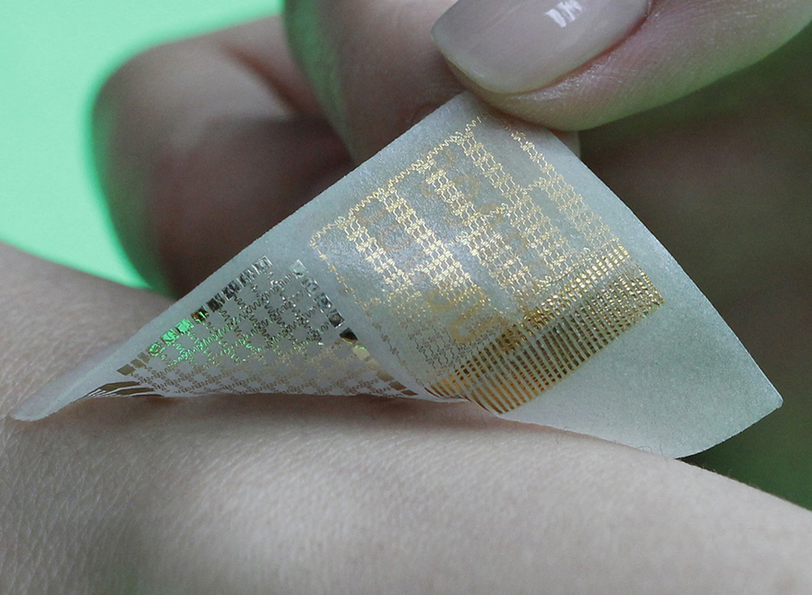
Smart Band-Aid
Nanoscale membranes embedded
into a stretchable, sticky fabric can detect tiny movements, deliver drugs and store all the necessary data
Multifunctional wearable devices for diagnosis and therapy of movement disorders, Nature Nanotechnology, March 2014, Son et al.

Slide 9
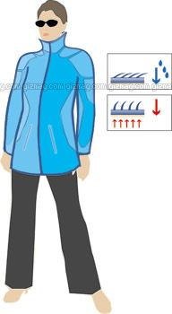
Smart Fabric/E-textile
adapts to changing temperature by opening when warm or shutting tight if cold
Source: Wikipedia

Slide 10
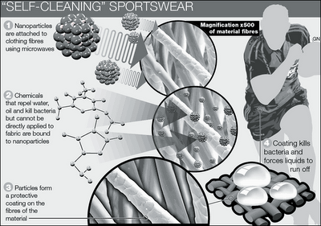
Source: telegraph.co.uk

Slide 11
Platelet TechnologyTM
Brinker Technology Platelet TechnologyTM
discrete particles released into pressurised pipe flow
when particles encounter modified flow at a leak, fluid forces entrain them into the leak and hold them against the pipe wall
seals and marks the position of the leak for subsequent detection.
(All figures courtesy of Brinker Technology)

Slide 12
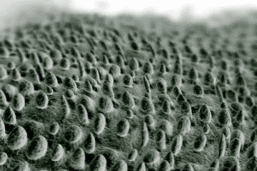
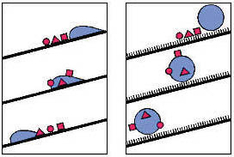
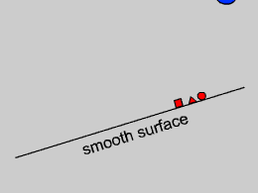
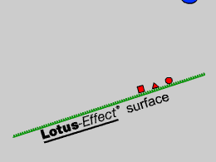
Biomimetics: Lotus effect
most efficient self-cleaning plant
mimicked in paints and other surface coatings
pipe cleaning in oil refineries (Norway)
Source: Wikipedia

