Slide 1
Smart Structures

Slide 2
Smart Structures
Most Common Definition
A Broader Definition (??)
Also include structures with
advanced multi-functionalities
through improved design, often bio-mimetic
Examples: de-icing /anti-drag coating,
Earthquake resistant design, nano-composites
A structure with abilities to
sense, diagnose, actuate, control,
learn (some or all) in order to perform
the designed function or maintain
structural integrity
Scope of the course

Slide 3
Components of a smart structures
Smart materials come
into picture
Distributed sensors and/or actuators
Microprocessors
Power sources
Central processing
Response from the sensors
Control commands to actuators
Power- & signal-conditioning electronics
Conventional displacement actuators: electro-magnetic, hydraulic,
servo- & stepper-motor
Conventional mechanical sensors: strain gauges, accelerometers , potentiometers
Advantages : large stokes, reliability, familiarity and low cost
Disadvantages: Weight, size, slow response, incapability to be tailored

Slide 4
Smart Structures Applications

Slide 5
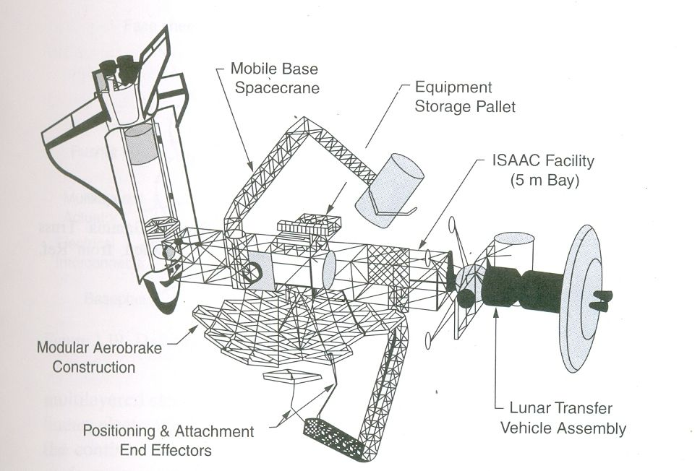
Space Applications
Vibration Control
Adaptive geometric truss configurations
Precision pointing of telescopes & mirrors
Structural integrity monitoring
Ref: Smart Structures Theory, 2013
Chopra and Sirohi, Cambridge University Press

Slide 6


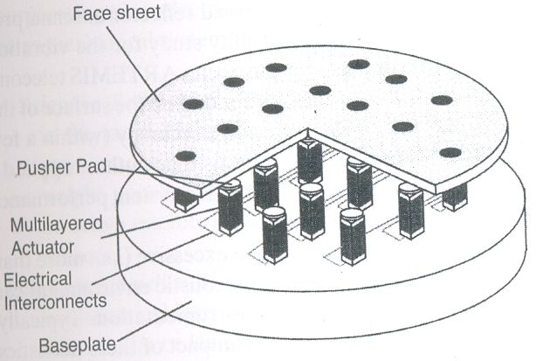
Space Applications
Replacement to pyrotechnics: Shape memory alloy based designs for compact and gradual release mechanisms, Micro Sep-Nut, QWKNUT for release of micro-satellites
Adaptive deformable mirror with distributed electrostrictive actuators
Ref: Smart Structures Theory, 2013
Chopra and Sirohi, Cambridge University Press

Slide 7
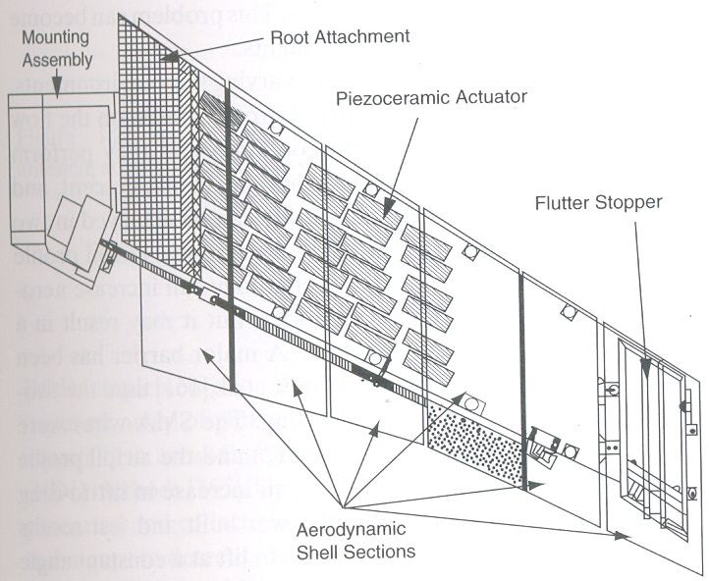
Aircraft Applications
Active vibration control
Wing-flutter stability augmentation
Increasing static divergence
Increasing panel flutter stability
Interior noise control
Shape control (Morphing) for performance enhancement
Structural integrity monitoring
Ref: Smart Structures Theory, 2013
Chopra and Sirohi, Cambridge University Press

Slide 8
Smart Wing Program
Active wing twist control using SMA
torque tube
16% scale model of a typical fighter wing
was fabricated and tested in NASA Langley
Dynamics Tunnel (TDT)
A tip twist of 1.4o to 3.6o was achieved in wind
tunnel with a maxm increase in lift of 11.5%
Ref: Smart Structures Theory, 2013
Chopra and Sirohi, Cambridge University Press

Slide 9
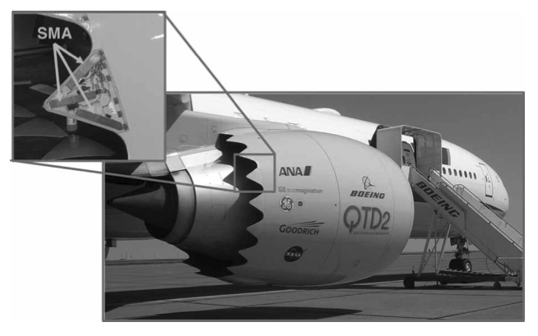
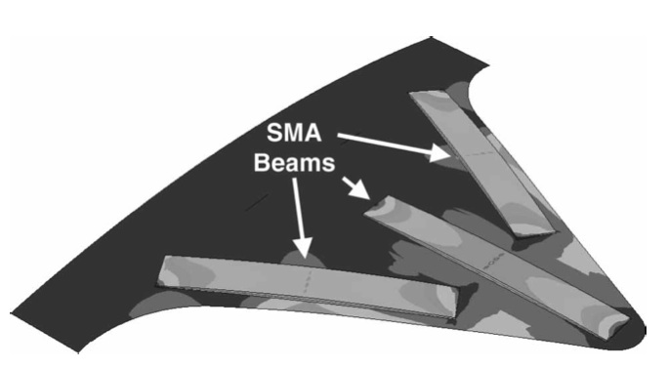
Boeing Variable Geometry Chevron
SAMPSON: Smart Aircraft and Marine Propulsion System
Ref: boeing.com/news
At higher altitudes and high speeds where the engine temperature is low, the chevrons relax and straighten-out. This guarantees a smooth exit flow that decreases the pressure difference between the inlet and exit of the engine and thus increases the engine thrust
chevrons bend inwards into the bypass flow at low altitudes and low speeds where the engine temperature is high reducing
the noise at take-off & landing

Slide 10
Shape Control of Engine Inlet
Fixed inlet geometry cannot provide the best performance
under all flight condition
A full scale adaptive inlet of an F-15 Eagle aircraft was built
Using SMA actuators
The concept was flight tested over a range of Mach numbers
Two wind tunnel test at NASA Langley 16ft TDT, demonstrated
the desired two-way control of the inlet cowl and lower lip
It took 30 seconds to move the cowl by 9 degrees.
Uniformity of temperature among wires and cooling time were
major concerns
Ref: Aerospace Applications of Shape Memory Alloys,
Hartl & Lagoudas , Jl. of Aerospace Engineering, 2007

Slide 11
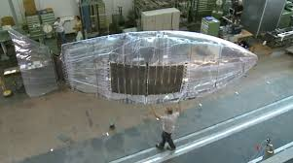
EAP activated airship
Specifications
• Length 6 m
• Velocity 1 m/s
→ Deflection angle up to 30º
→ Strain up to 15 %
→ Frequency 0.2 Hz
Fish-like propulsion of an airship based on electro-active polymers
C. Jordi, E. Fink, S. Michel and P. Ermanni

Slide 12
Smart Materials

Slide 13
Smart Materials
Definition:
A smart materials can be described as a material that has a useful response
to external influences or stimuli and usually convert energy between multiple physical
domains
Coupling effects (in context of smart materials):
Change in one physical causes change in another physical domain
Examples
One – way coupling
Thermo-mechanical coupling: Change in temperature results in change in mechanical
strain
Two – way coupling
Electro-mechanical coupling: Coupling between electrical and mechanical domains
Piezoelectric effect
Electro-thermal coupling (Pyroelectric effect): Coupling between electrical and
thermal domains

Slide 14
Stress, strain, displacements
Direct
Piezoelectric effect
Coefficient of
Thermal expansion
Converse
Piezoelectric effect
Pyroelectric effect
Electric field, voltage
Temperature, entropy
Joule heating

Slide 15
Common Smart Materials Used in Smart Structures
Piezoelectric materials
Shape Memory Alloys (SMA)
Electro-rheological (ER)/ Magneto-rheological (MR) fluids
Electrostrictive materials/Magnetostrictive materials
Fiber Optics
Electro-active polymers

Slide 16
Electrostrictive materials
Electrostriction is an induced deformation under the influence of an applied electric field
Unlike piezoelectric effect, which is linear with electric field, the electrostrictive effect is quadratic with electric field
Induced strain due to electric field is quite comparable to piezoelectric
Electrostrictors generally elongate in the direction of the field and contract normal to the field, irrespective of whether the field is positive or negative
A major limitation of electrostrictive material is temperature sensitivity
They exhibit negligible hysteresis and creep
For motion control applications, like micro-positioning, one can expect repeatable performance
Tilt mirrors of planetary camera II of Hubble Space Telescope was launched with an incorrectly configured primary mirror. It was repaired with six electrostrictive actuators that provided full ground control and saved $7 billion investment.

Slide 17
Most common use of
Fiber Optics:
Transmission of data, telecommunication, transmission is done using light
In context of Smart Structures:
Sensing of physical parameters like strain, temp., pressure etc.
Basic working principle:
Total internal reflection of light, “pipe” light from one place to another
Refractive index of core (n₁)
>
Refractive index of cladding (n₂)
Basic Design of Fiber Optic
n₁ – n₂ = 0.0001 to 0.0002
Core: extremely low impurity glass
5 μm for single mode fiber
100 μm to 200 μm for multi-mode fiber
Cladding: Fluorine doped glass
125 μm in diameter
Cladding
Core

Slide 18
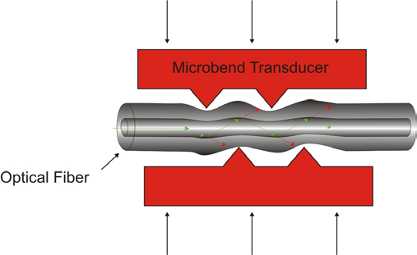
Fiber Optic Sensors
Basic Principle:
The parameters under study like strain, pressure,
temperature etc., changes the optical parameters
like intensity, phase, polarization, wavelength, frequency etc.
of the light propagating through the fiber. These changes are
measured and related to the sensed parameters.
Examples
Pressure and deformation measurements
Loss of intensity

Slide 19
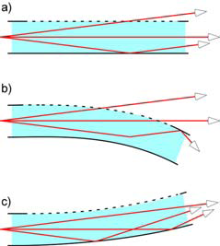
Examples
Principle of curvature measurements
using FO intensity measurements
Advantages of Fiber Optics Sensors:
Light-weight, low power requirement, high sensitivity, wider bandwidth, environmental ruggedness

