Slide 1
Piezoelectric Material
Several figures in the slides have been taken from different sources

Slide 2
Piezoelectricity
Pierre Curie and his brother Jacques first discovered the piezoelectricity phenomenon in quartz and Rochelle salt in 1880 and named the effect piezoelectricity (from Greek piezein, “to press”).
– Piezoelectric effect was first found in certain crystalline minerals: zinc blende, tourmaline, quartz, rochelle salt, can sugar, etc.
– In 1940, piezoelectricity was demonstrated in the first synthetic piezoelectric substance – Barium Titanate (BaTiO₃).
Most widely used piezoelectric material is Lead Zirconate Titanate (PbZrTiO₃) commonly known as PZT
Direct Piezoelectric Effect
Inverse (/converse) Piezoelectric Effect
Electric charge generation across the material due to mechanical strain
Mechanical strain due to application of electric voltage

Slide 3
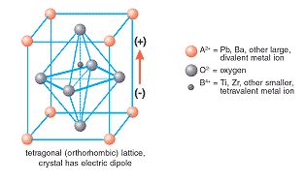
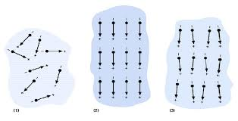
Piezoelectric behavior
c-axis
Piezoelectric material has an inherent dipole moment (in direction
of c-axis) & thus a spontaneous polarization
A volume of unit cells with their dipole moments oriented in the
same direction is called a domain
The direction of the unit cells can change from one domain to the next,
Rendering the total polarization of a sample zero
b-axis
a-axis
Direction of electric field applied
(poling direction)
+ + + +
Poling :
Application of high electric field (2000 V/mm) at
an elevated temperature results in realignment of the
domains in a way that the dipoles are mostly oriented
in the direction of the applied field
- - - -

Slide 4
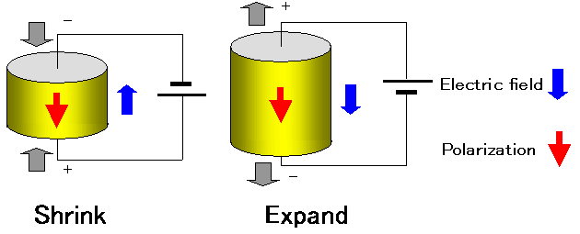
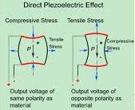
Piezoelectric sensors and actuators
Inverse piezoelectric effect : Actuation
Direct piezoelectric effect : Sensing

Slide 5
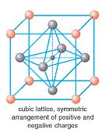
Curie Temperature
If a piece of piezoelectric material is heated above a
certain temperature, called a Curie temperature, it will
lose piezoelectric properties. After cooling below the Curie
temperature, the piezoelectric material will NOT regain its
piezoelectric properties
Above the Curie temperature, it exhibits simple cubic symmetry, with no dipoles moment

Slide 6
Mechanical Limitations
– Mechanical stress sufficient to disturb the orientation of the domains in a piezoelectric material can destroy the alignment of the dipoles. Dropping a piezoelectric element could kill the material!
Thermal Limitations
– If a piezoelectric ceramic material is heated to its Curie point, the domains will become disordered and the material will be depolarized. The recommended upper operating temperature for a
ceramic usually is approximately half-way between 0°C and the Curie point.

